Slide 1
Grassland plants and soils
(KS2)

Slide 2
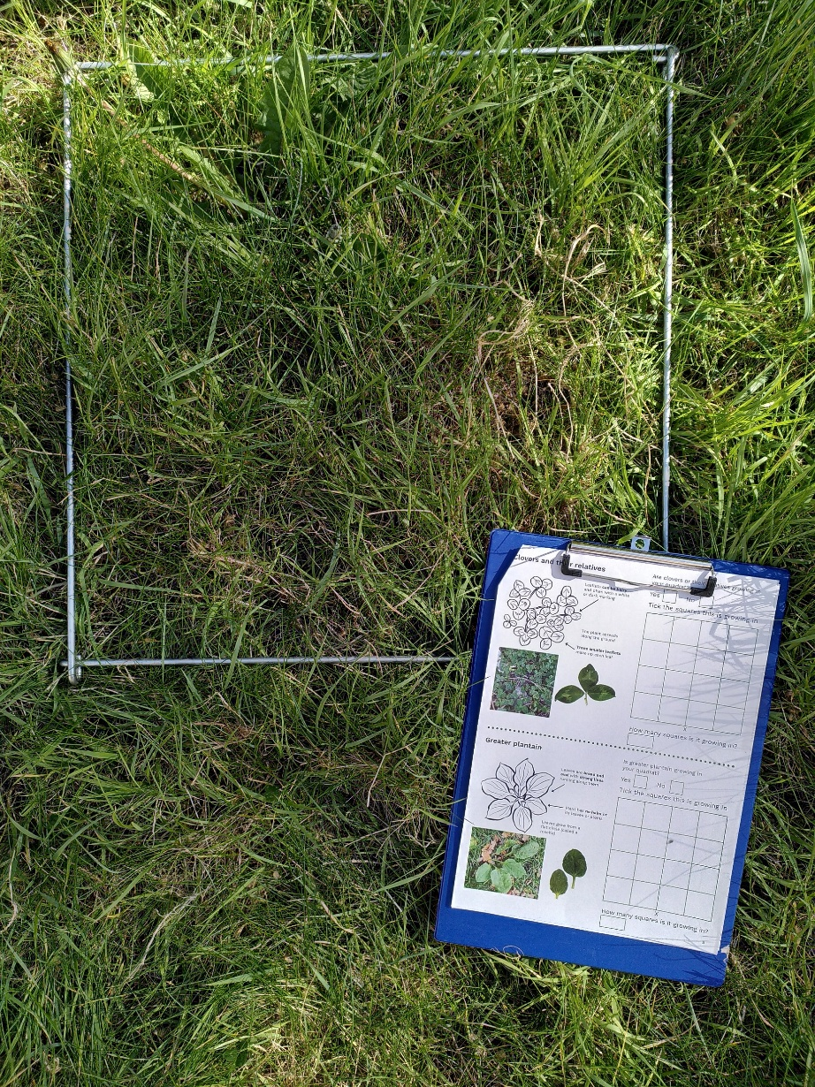
The Grassland Plant Survey
Note for teachers
This resource can be used to support your learners to take part in the Grassland Plant Survey. The survey is based on species lists used by the National Plant Monitoring Scheme to classify habitats in the UK.
While the plants in this survey cannot be used to exactly classify the habitat, the information can be used to infer the health of the grassland habitat and gives an indication of biodiversity in an area.
This information can help with wider decision-making about how space is used and how nature can be supported while still meeting the needs of people using the space.

Slide 3
Learning outcomes
understand that plants live in habitats to which they are suited, and get much of what they need from the soil
understand that human activities have effects on soils, and that this affects what plants can live in a habitat
able to infer things about soils and habitats by using the presence or absence of indicator species

Slide 4
Key vocabulary
Indicator species - an organism whose presence, absence, or population size tells us something about the environment or ecosystem
Generalist - organisms that can live and reproduce in a wide range of habitats
Tolerant – able to survive, grow, and reproduce under certain conditions
Nutrients - any substance that living things need to survive and grow
Notes:
See the Grassland indicator vocabulary presentation for more details and examples.

Slide 5
Key vocabulary
Disturbance - something that breaks up the soil surface
Trampling - stepping on something
Mowing - cutting grass shorter, usually with a machine
Compaction - squashing together soil particles. More compaction slows the rate at which air and water can move through the soil
Notes:
See the Grassland indicator vocabulary presentation for more details and examples.

Slide 6
How indicator species work

Slide 7
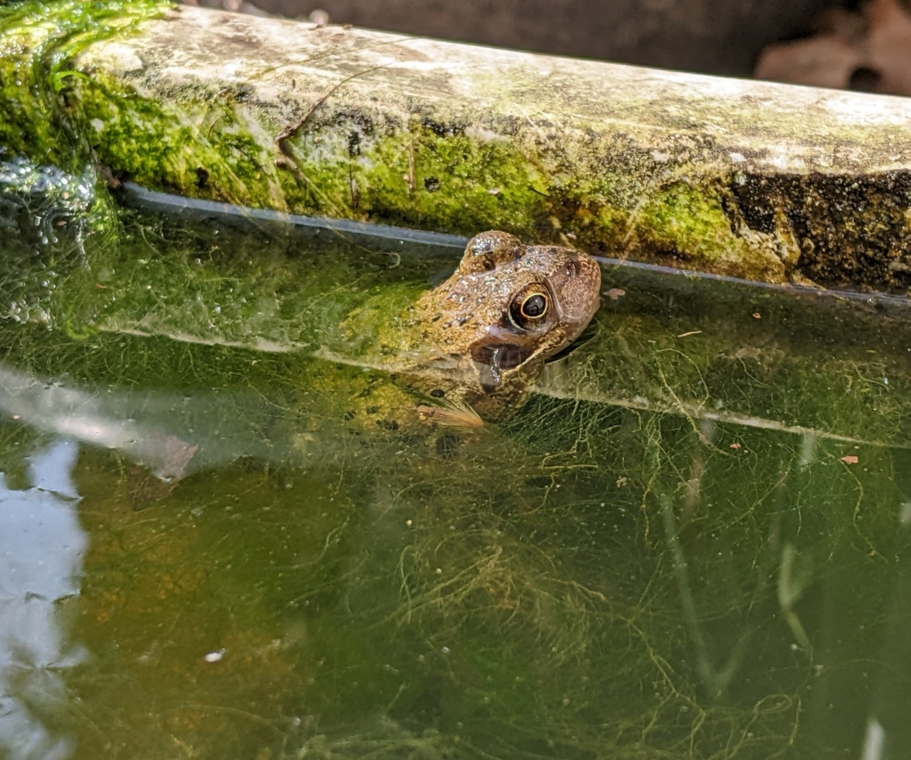
Indicator species
An organism whose presence, absence, or population size tells us something about the environment or ecosystem.
Example
A frog can tell us that there may be a pond in the area. A healthy population of frogs is a good indication that the pond ecosystem is also healthy.
Notes:
To indicate is to show something or point something out. An indicator species points to some information about the habitat or ecosystem.

Slide 8
Investigating a habitat with plants
Indicator plant | Mowing tolerance | Compaction tolerance | Nutrient levels
Common Mouse-ear
Greater Plantain | Tolerant | Tolerant | Low
Dock |  |  | High
Daisy | Tolerant | Tolerant
Dandelion | Tolerant | Tolerant | High
Clovers | Tolerant
Yarrow | Tolerant
Yellow-rattle | Not tolerant
The indicators included in the Grassland Plant Survey needed to be common and easy to recognise.
The plants are useful indicators of important qualities of soil.

Slide 9
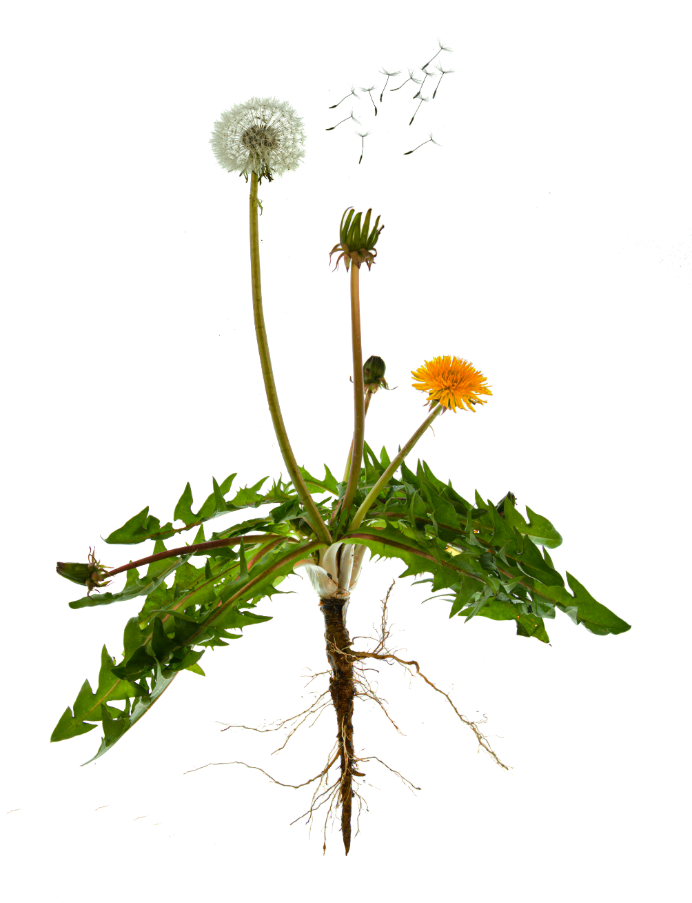
Nutrients
Some of the nutrients plants need to grow
Any substance that living things need to survive and grow.
In animals, nutrients come from the food they eat. In plants, many nutrients come from soil and are absorbed by the plant’s roots.
Plants can also make some of their own nutrients. Plants use carbon dioxide, water, and sunlight to make sugars.
Carbon dioxide
Nitrogen
Phosphorous
Water
Potassium

Slide 10
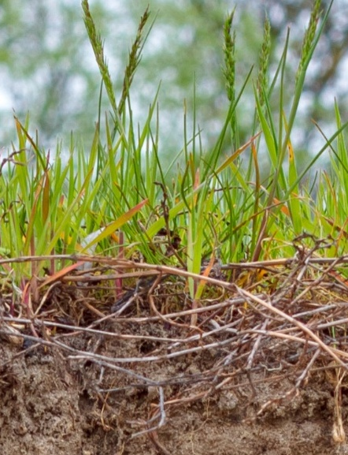
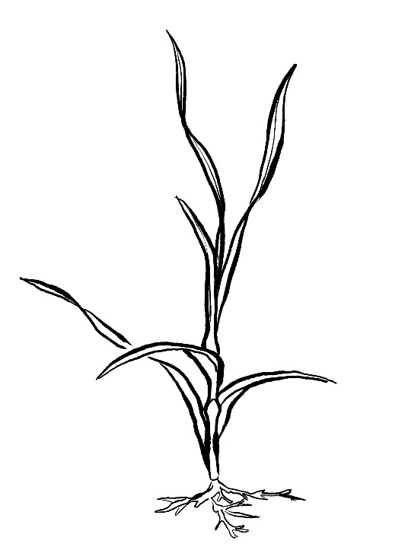
Grasslands
Grasses are the main plants in a grassland habitat.
If there are a lot of nutrients available in the soil, grasses can grow very quickly. The roots of grasses can grow into tight mats. Other plants can have trouble pushing through to reach the soil.
Finding grasses and very few other plants can indicate that fertilisers are being used.
Grass
Imagine being another plant trying to grow through these grass roots!

Slide 11
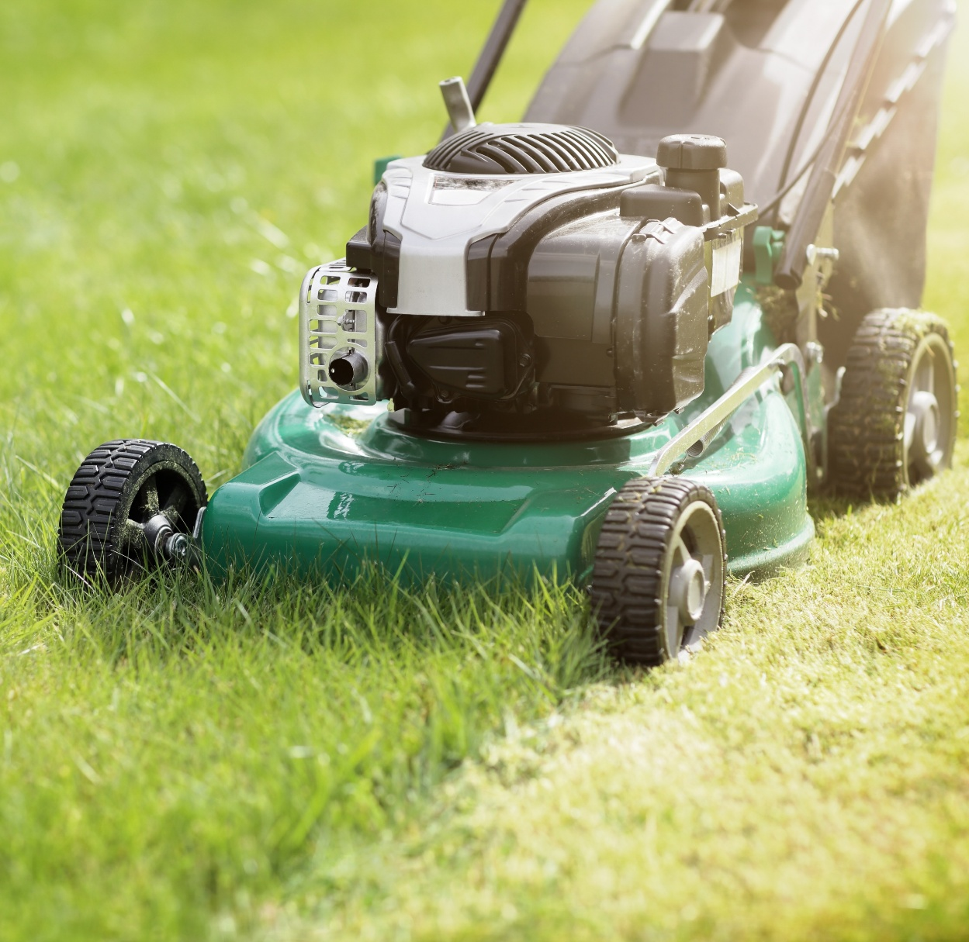
Mowing
Cutting grass shorter, usually with a machine.
Different methods for keeping grass and other plants short have different impacts on a grassland ecosystem.* Some other ways humans keep grass short include:
grazing with domesticated animals such as cows or sheep
cutting with a scythe
Notes:
Mowing can also result in:
Very even vegetation height.
Removal of nutrients (if cuttings are collected in a bag).
Inability for some plants and animals to complete their lifecycles. Flowers can be cut off taller growing plants. Some insects lay their eggs or pupate on of in grasses and plant stems.
Grazing can also result in:
Uneven grass and vegetation height.
Animal footprints and uneven soil surfaces. These can help with water retention. Instead of flowing off the land, water can collect in the footprints and soak into the ground.
Dung. Decomposition of dung returns nutrients to the soil, and supports a wide variety of insects such as dung beetles.
Scything can also result in:
Less frequent cutting (because it is manual), which can allow more plants and wildlife to complete their lifecycles.
More time for wildlife to move out of the way. Scything is slower than mowing.
Spreading seeds. The cut plants are often left in place for a while before collection, giving time for seeds to drop from plants.
More information:
The Living Meadow: How Mowing Affects Insects and Spiders – Frontiers for young minds - https://kids.frontiersin.org/articles/10.3389/frym.2025.1565644

Slide 12
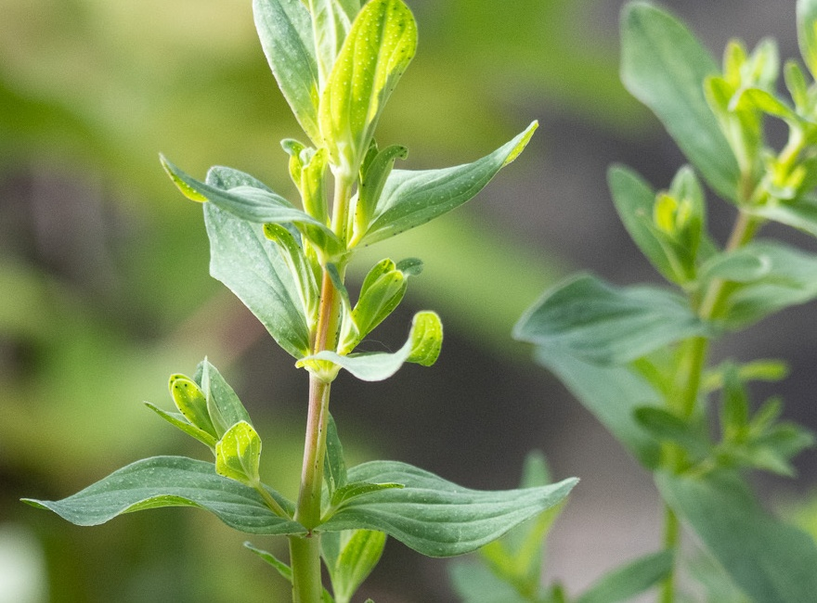
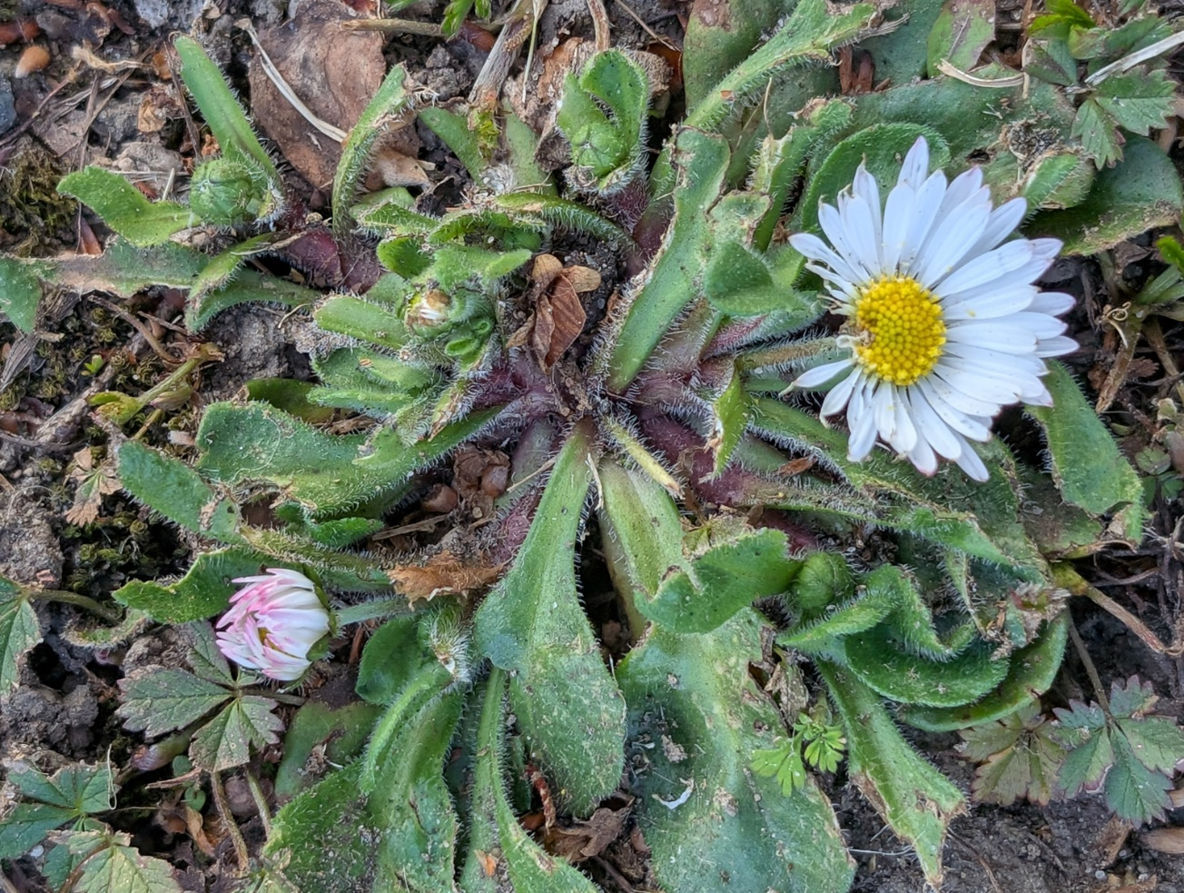
Some plants grow from buds along the stem. Mowing grazing by animals might kill these plants.
Other plants grow low to the ground and make a circle of leaves called a rosette. These plants can avoid lawn mowers.
Can you see where this daisy’s leaves were chopped off by a lawn mower?

Slide 13
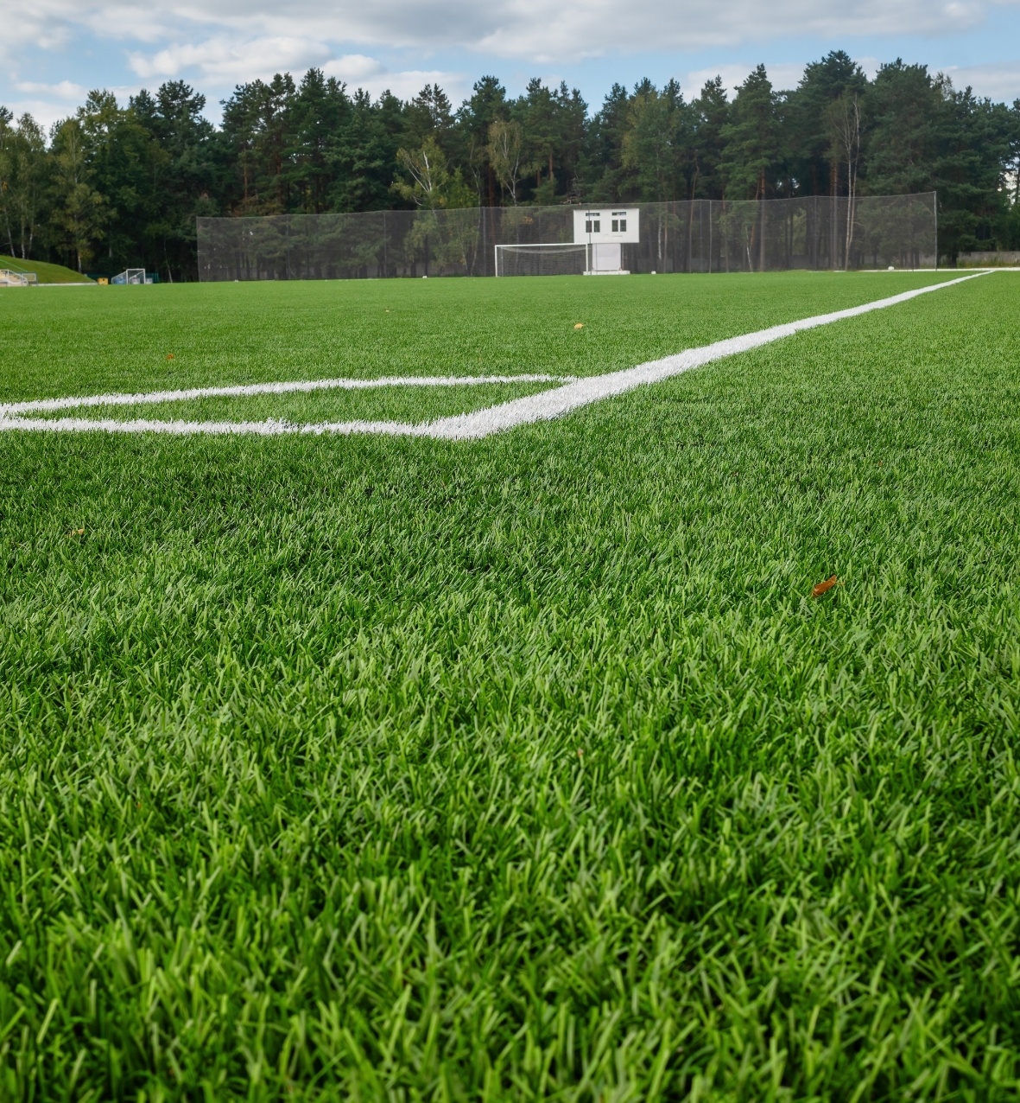
Lawns
How many types of grass can you spot in this sports field?
Human-made grasslands that are highly managed and fertilised, such as football pitches and golf courses, might have as few as one or two grass species and very little other biodiversity.
Sometimes specific types of grass are grown on playing fields to suit the needs of the sport.
Notes:
What problems could be caused by having clumps of different types of grass growing in a playing field?
A few ideas:
Some grasses are more delicate
Some have very stiff leaves
Some grow into big, tall clumps

Slide 14
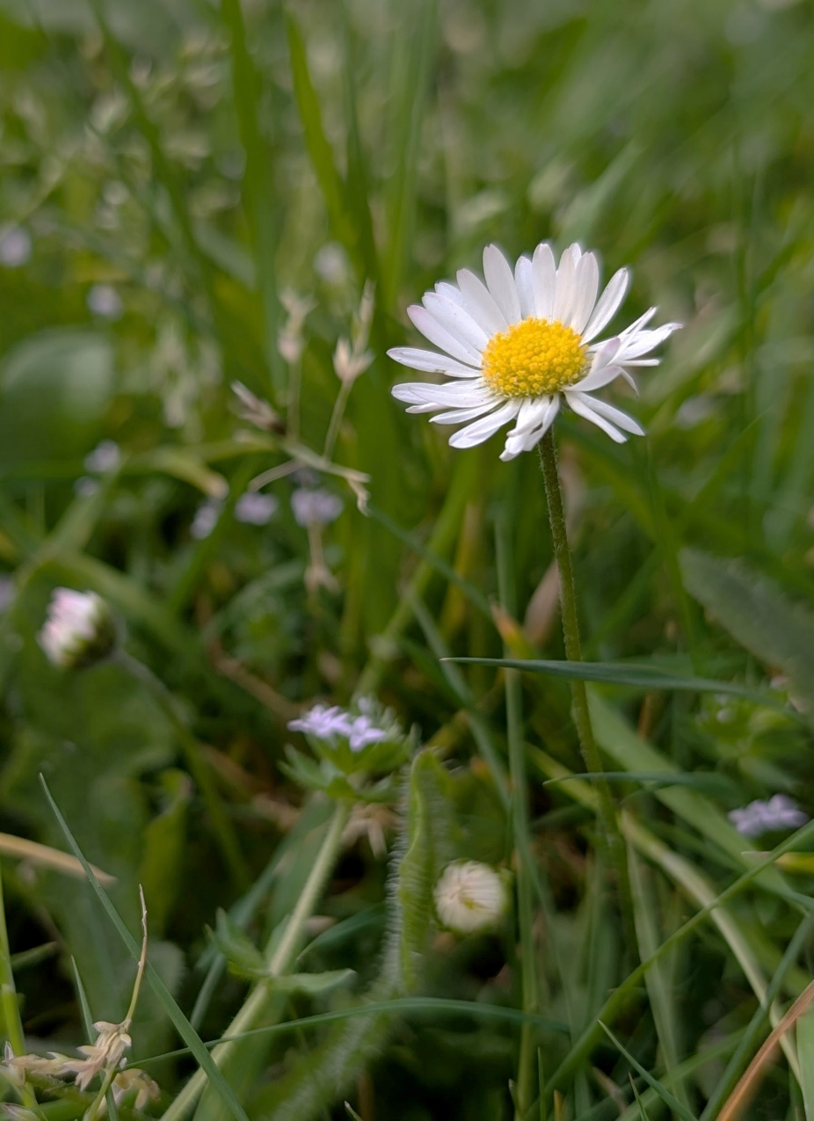

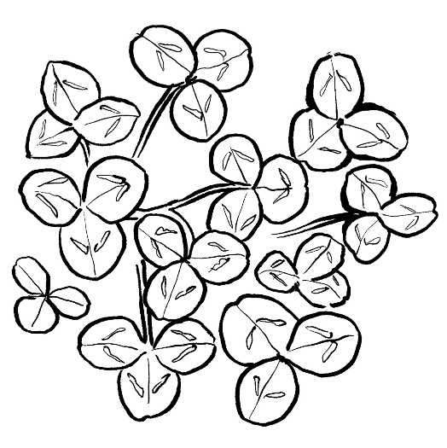

Grassland plants
Intensively mown and managed grasslands like lawns can still have some biodiversity.
These plants can grow and compete with grasses under a wide range of conditions. They are common in many grasslands, including meadows and human-made lawns.
Yarrow
Clovers and their relatives
Common daisy

Slide 15
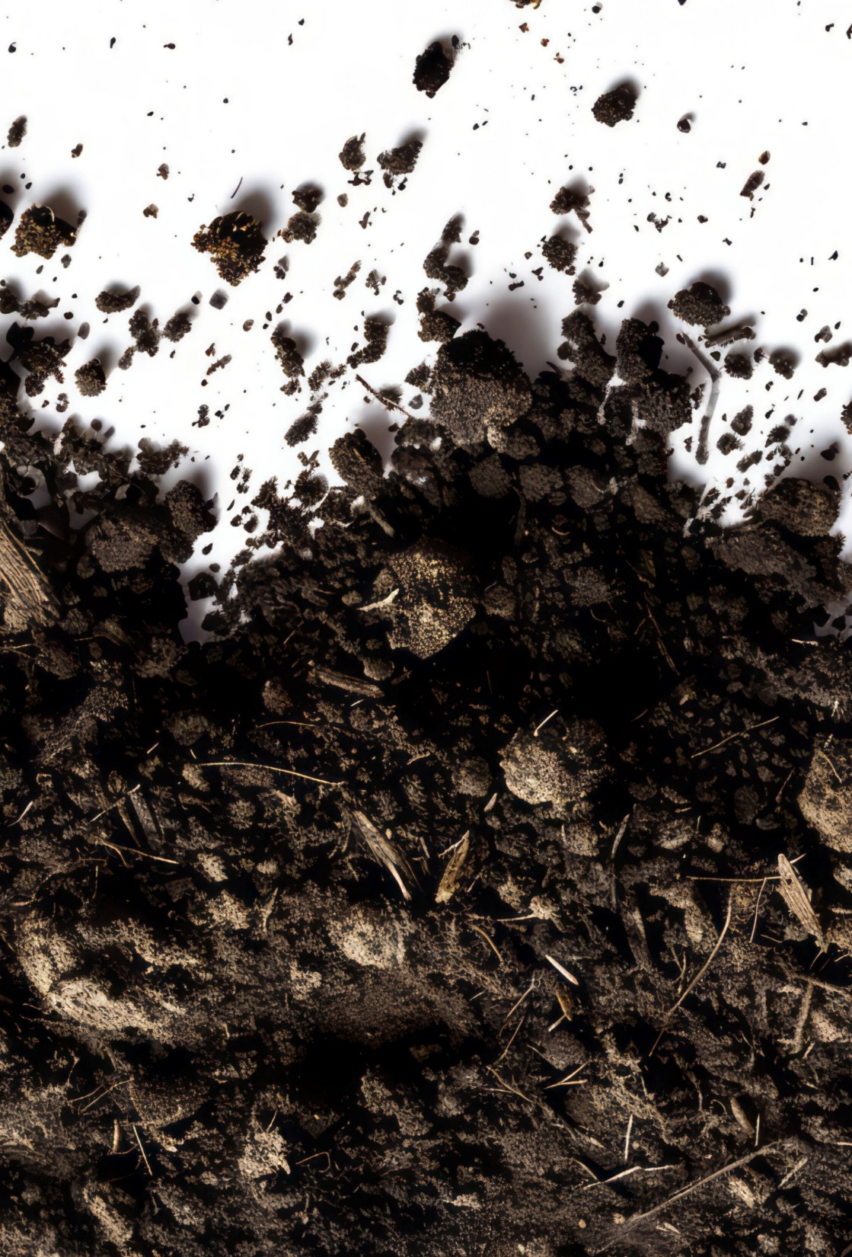
Key vocabulary
Less compacted soil particles
Compaction
Squashing together soil particles. This reduces the rate at which air and water can move through the soil.
More compacted soil particles

Slide 16
Demonstration
Test 1
Fill a funnel with potting soil.
Pour water on the soil.
Time how long it takes for the water to start coming out the bottom of the funnel
Test 2
Repeat test 1, but first press firmly on the potting soil before pouring the water.
Pressing on the potting soil squeezes together (compacts) the soil particles. The smaller spaces mean water and air move through the soil more slowly.

Slide 17
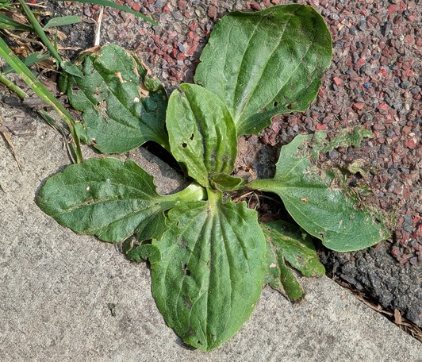
Plant roots take in water for the plant. Plant roots also need oxygen.
Compaction slows down the spread of water and fresh air into the soil.
Some plants have roots that can tolerate growing in tight spaces with little water and oxygen. These plants can grow in these difficult conditions where other plants will struggle.
Greater plantain can live in very compacted soil. This greater plantain plant is growing in a pavement!

Slide 18
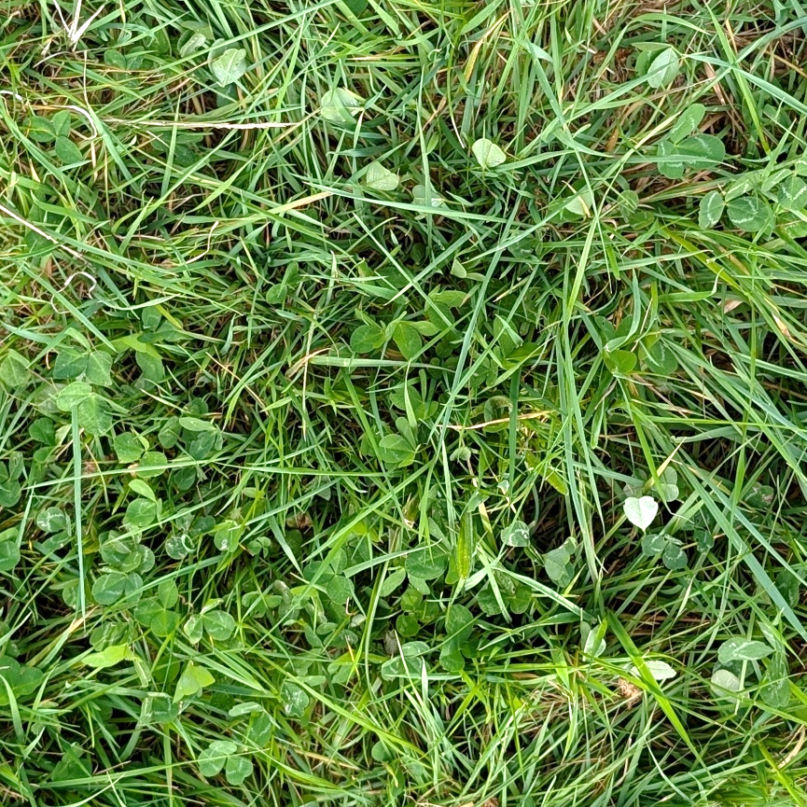
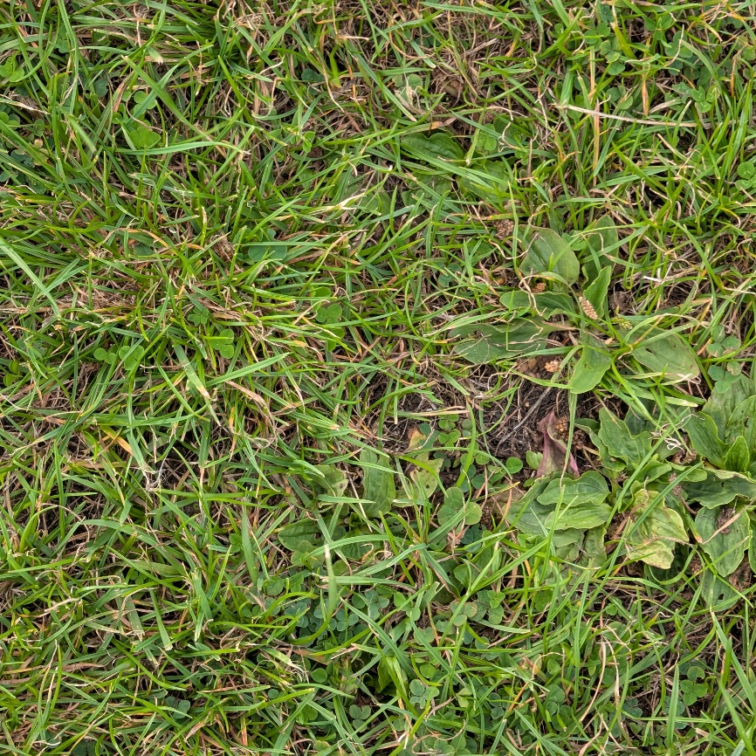
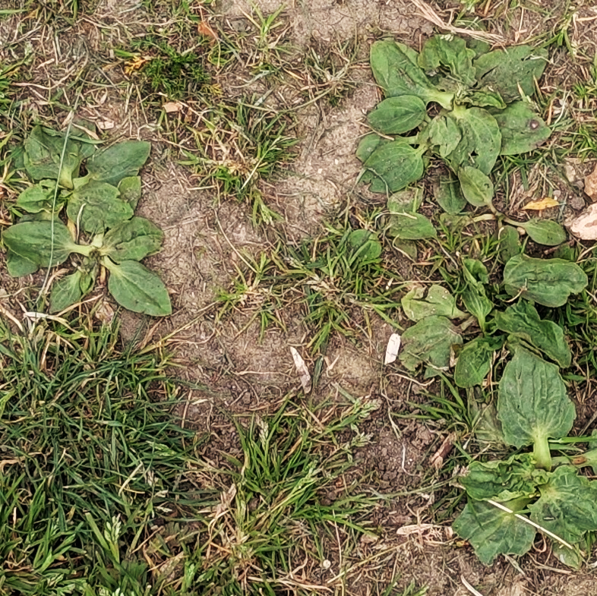
What differences can you see between these grassland quadrats?
What might these differences tell us about each grassland?
1
2
3
Notes:
1. Some differences learners might spot:
The area covered by clover decreases from quadrat 1 to 3.
The area covered by greater plantain increases from quadrat 1 to 3
2. Differences indicated include:
More plantain indicates Grassland 3 is likely more trampled and the soil more compacted than grassland 1.
Bare soil can indicate very high levels of foot traffic, making the soil very compacted and preventing many seedlings from surviving.

Slide 19
Nature Park grassland types

Slide 20
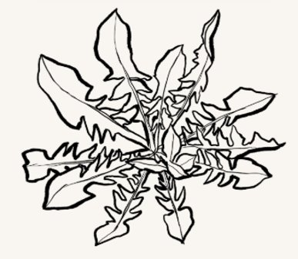
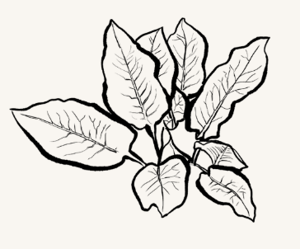
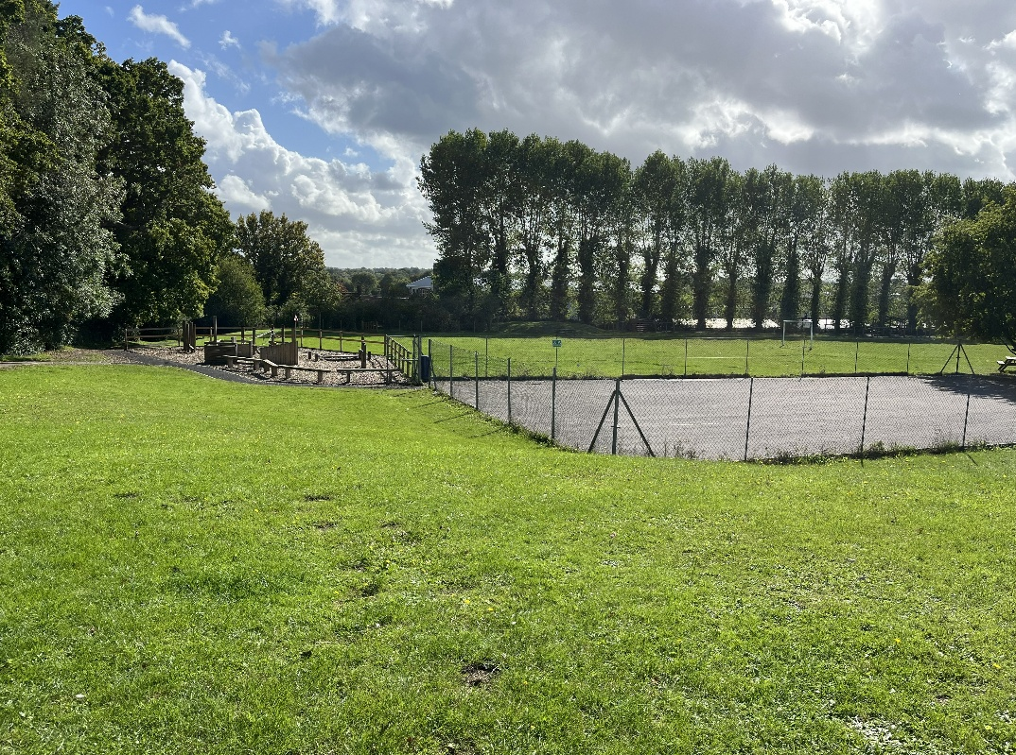

Playing fields or lawns
Nature Park habitat type
plants usually under 10cm tall
fewer than eight leaf types in a 1 sqm area
Indicators that soil may have lots of nutrients
Dandelion
Broad-leaved dock
Indicator that soil may be compacted, and/or have less nutrients.
Greater plantain

Slide 21
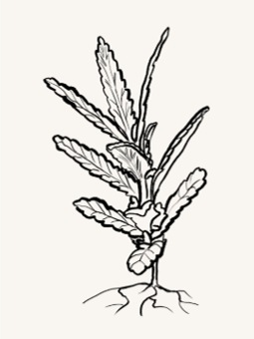
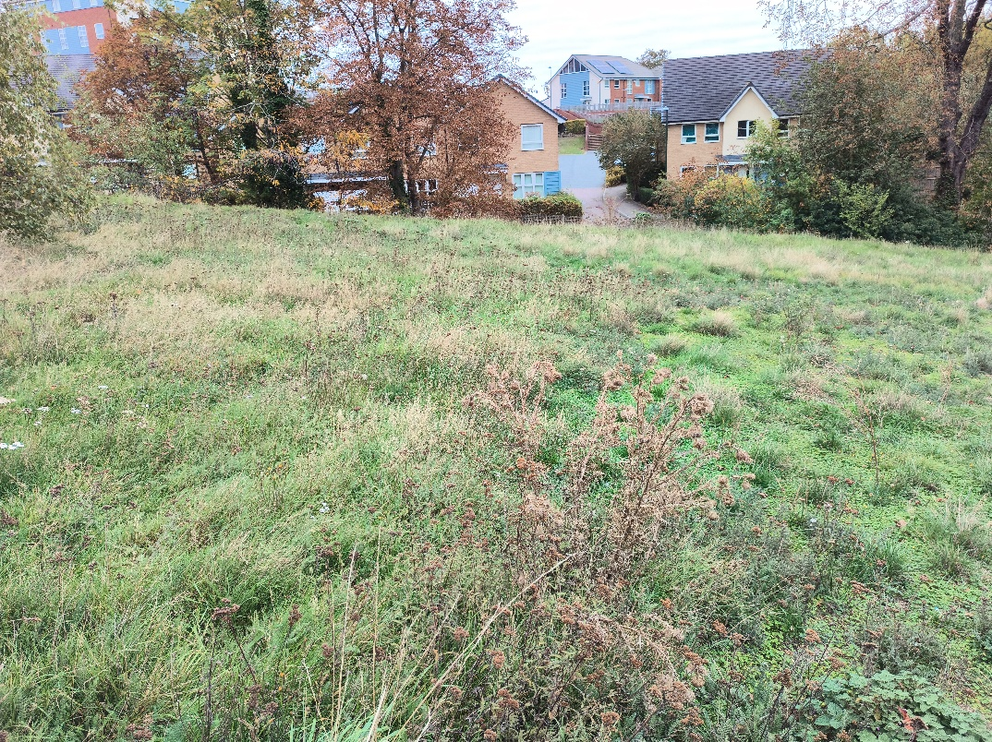

Meadow
Nature Park habitat type
plants usually more than 10cm tall
eight or more leaf types in a 1sqm area
Often seeded in grassy areas humans are trying to turn into meadows.
Yellow rattle
An indicator that the area is probably less disturbed or trampled.
Common mouse-ear

Slide 22
Grassland Plant Survey indicator species

Slide 23
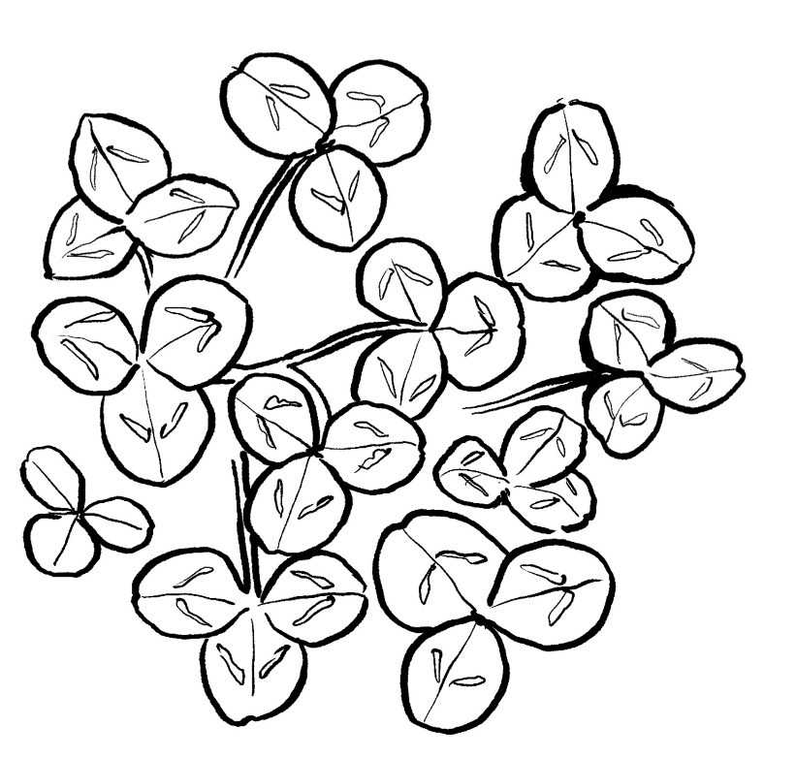
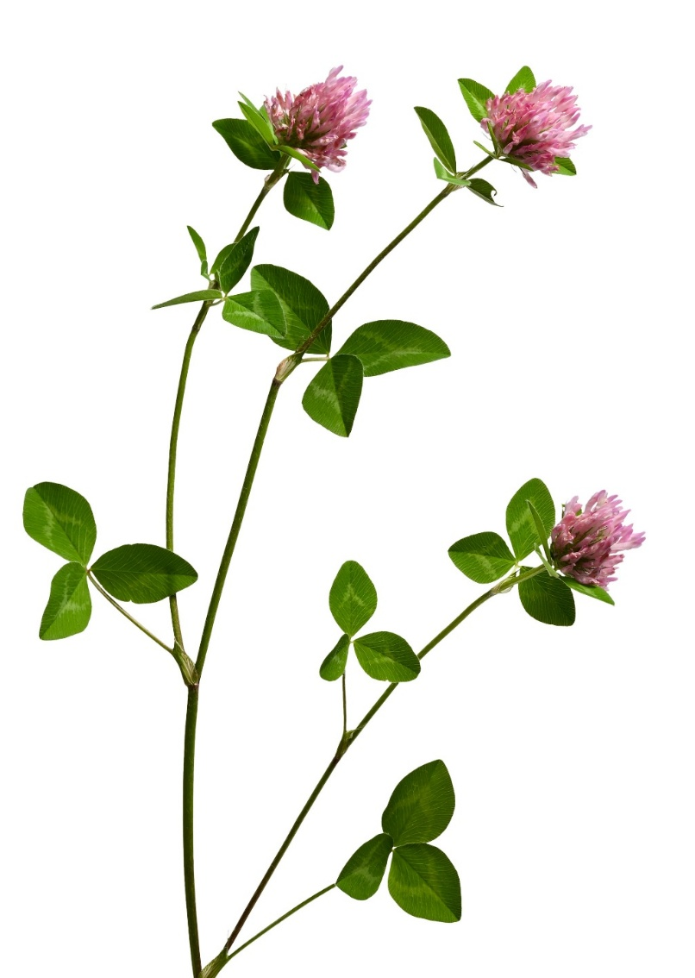
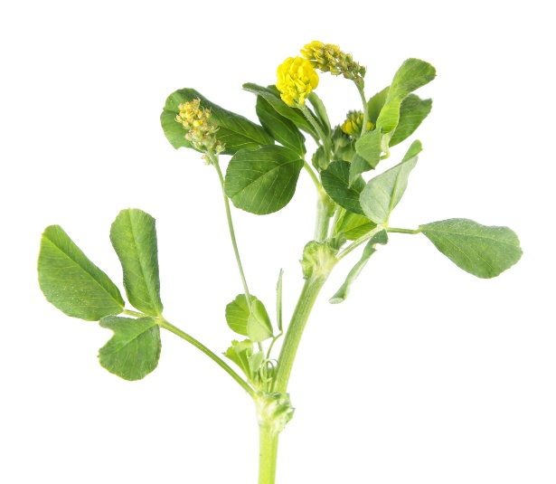
Clovers and their relatives
Tolerant of mowing and trampling.
Increases available nitrogen in the soil. Nodules on their roots host bacteria that convert nitrogen from air into forms the plants can use.

Slide 24
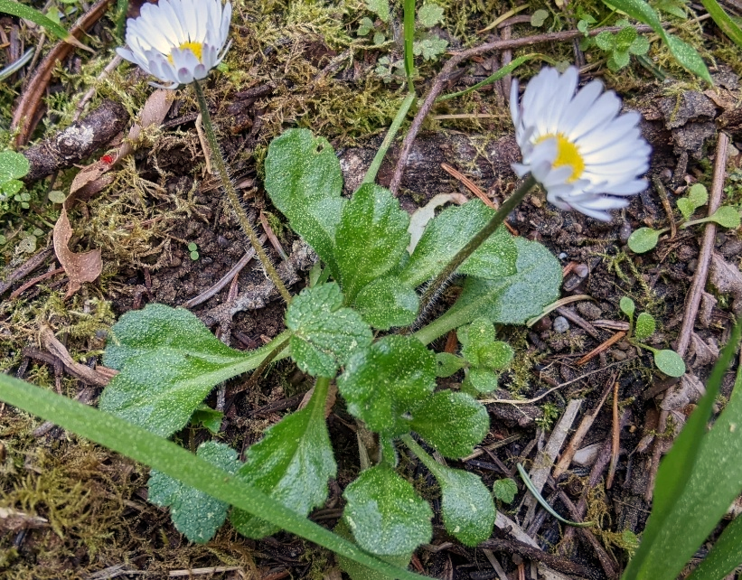

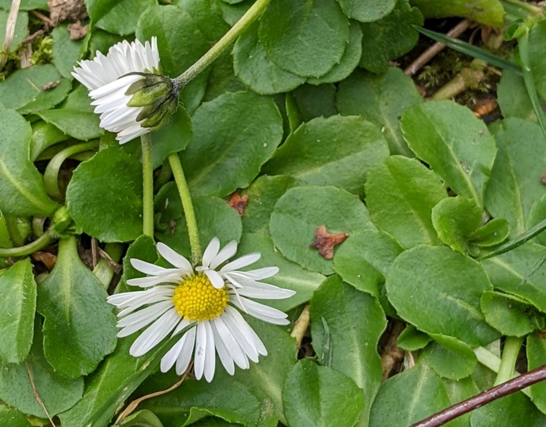
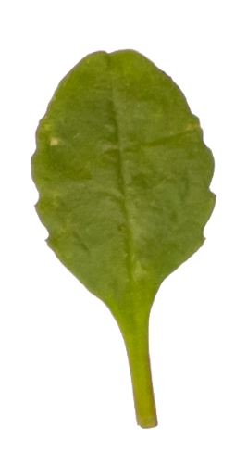
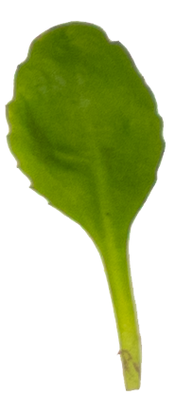
Common daisy
Tolerant of mowing and trampling.

Slide 25
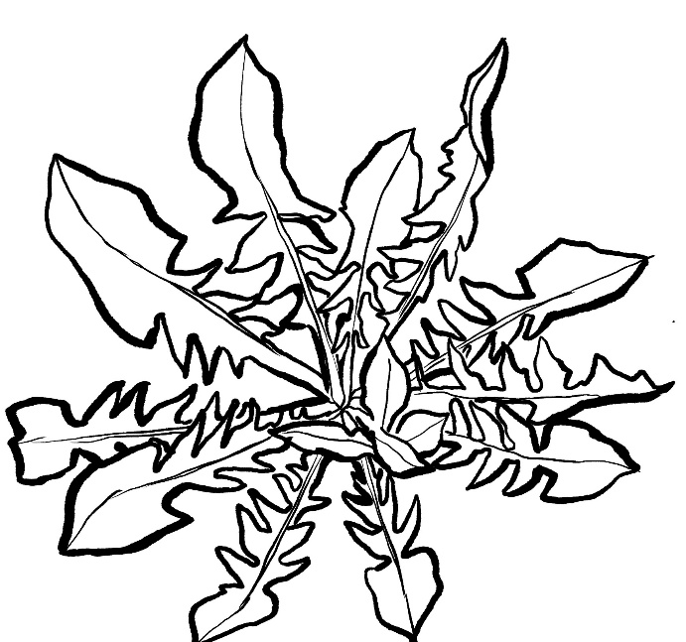
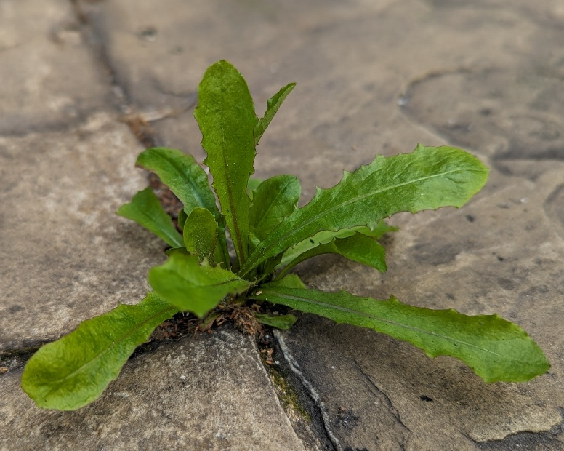
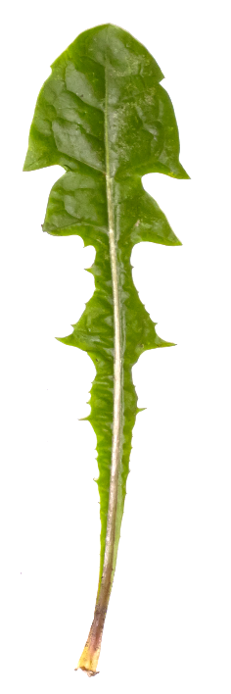
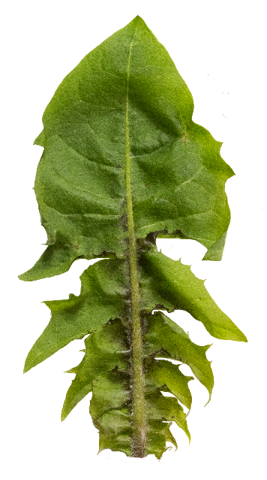
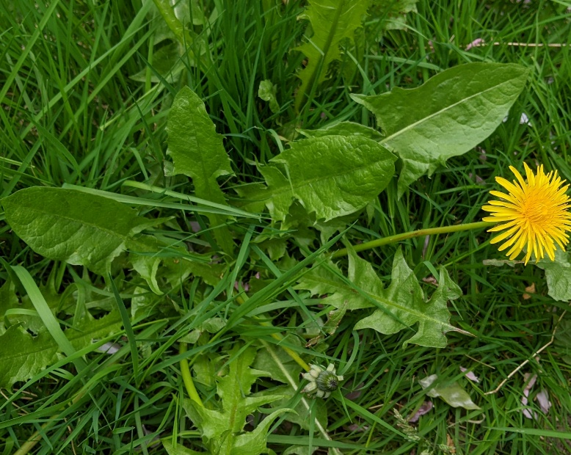
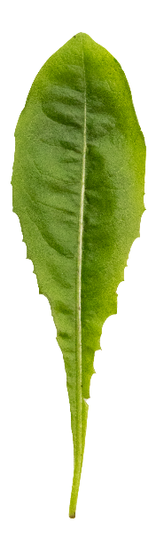
Dandelion
Thrives in high-nutrient environments and tolerant of trampling.
More than 200 closely related species in the UK.
Leaves from different dandelions

Slide 26
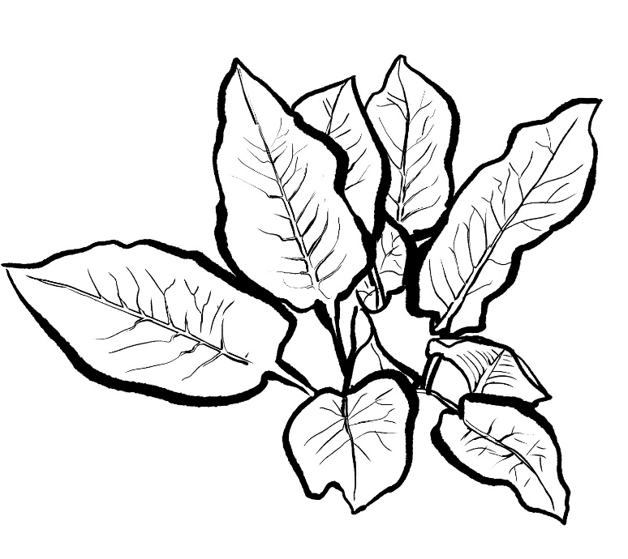
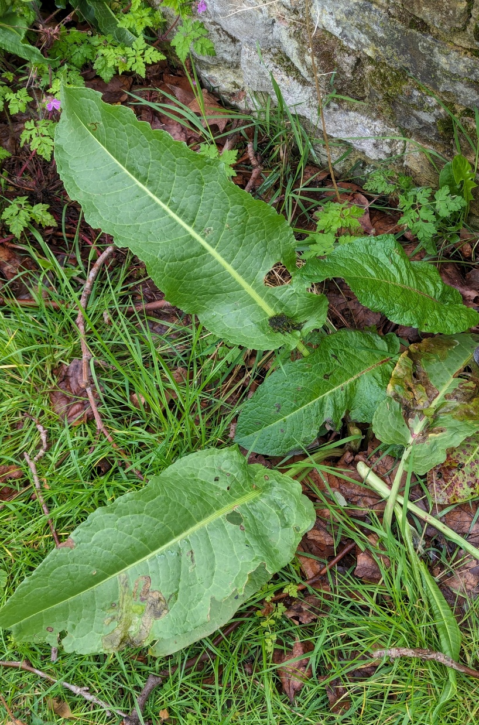
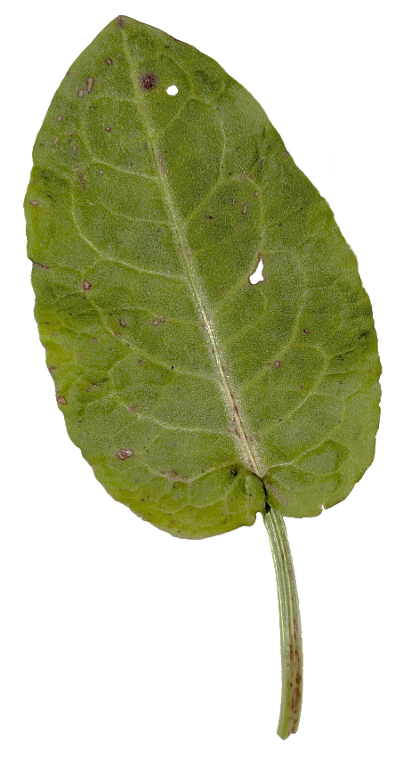
Broad-leaved dock
Thrives in high-nutrient and disturbed environments

Slide 27
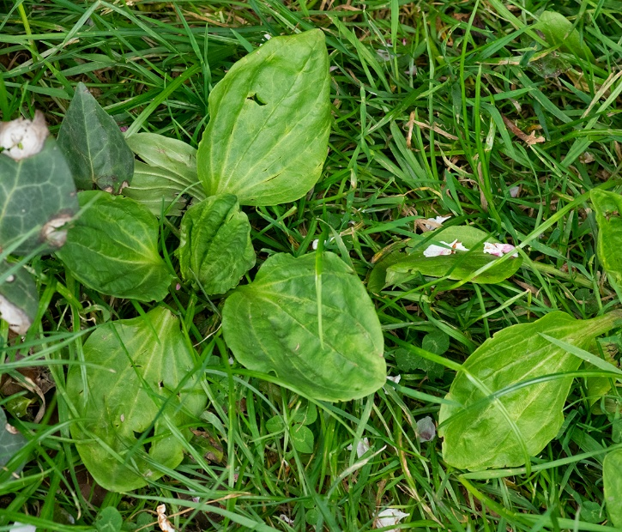
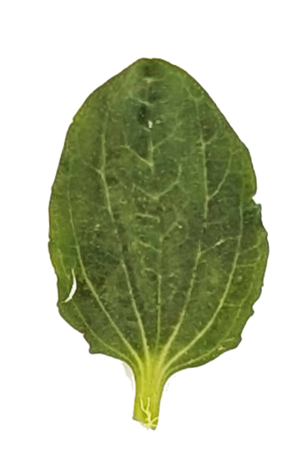
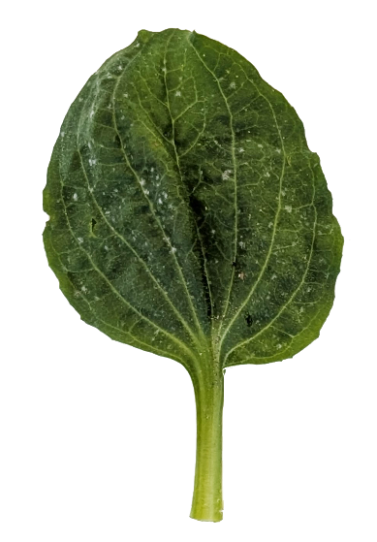
Greater plantain
Tolerant of trampled and disturbed environments

Slide 28
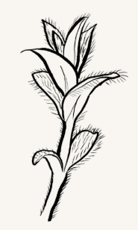
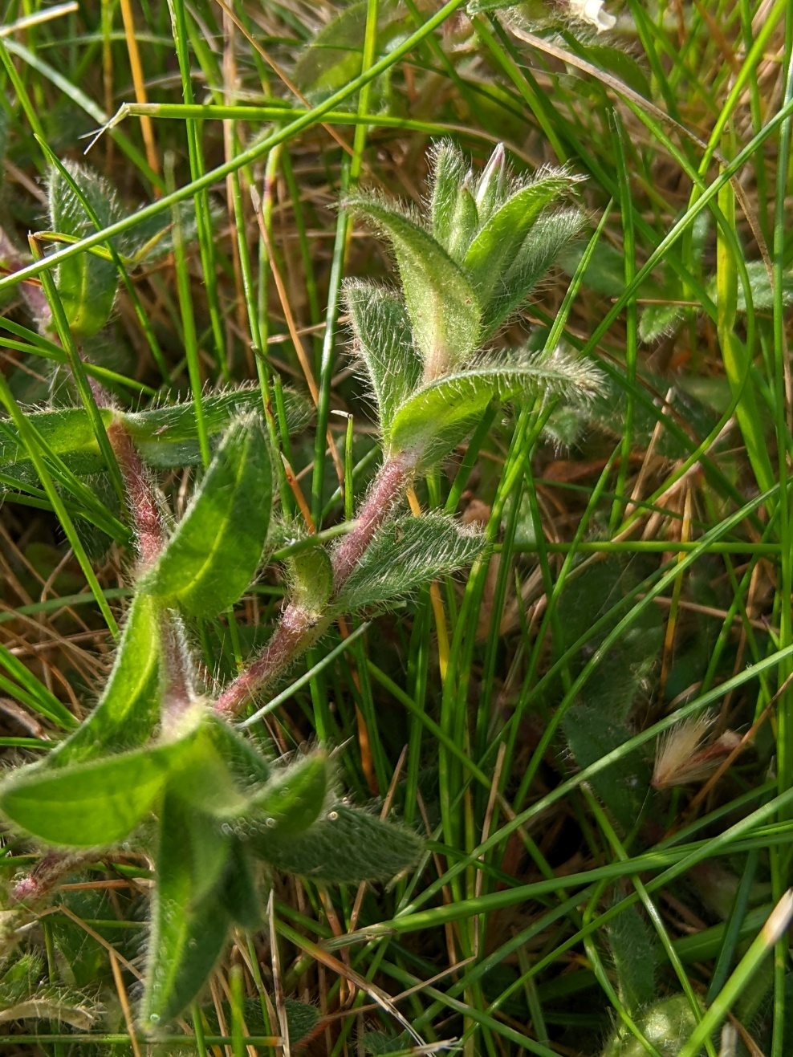
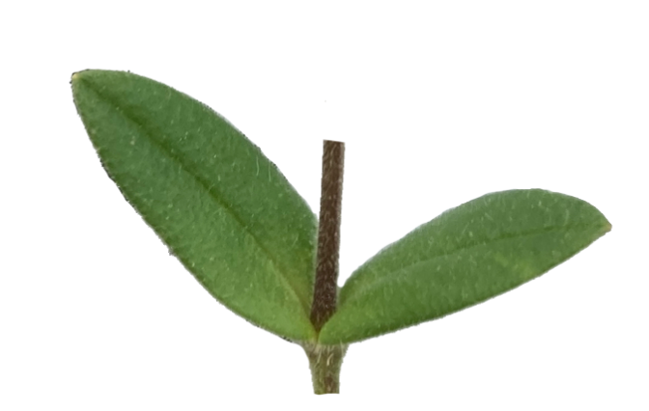
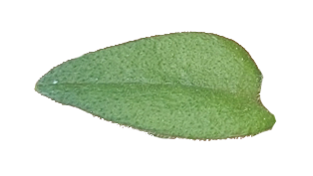
Common mouse-ear
Tolerant of high nutrients.
Less tolerant of trampling and disturbance.

Slide 29
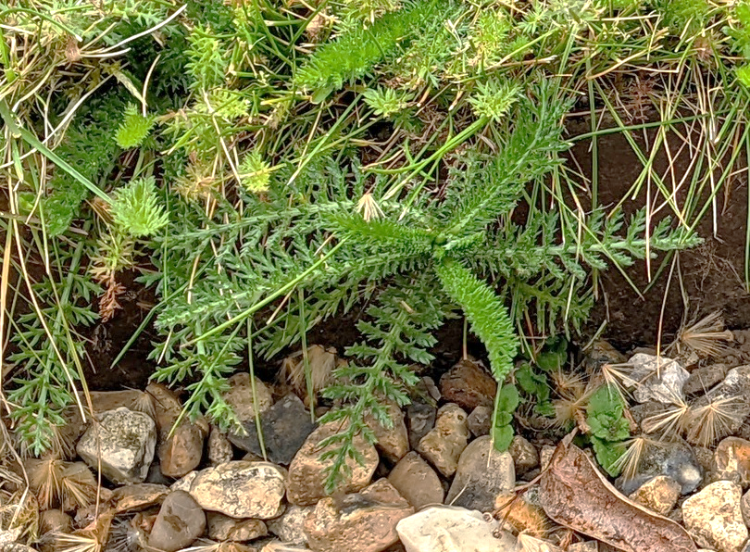
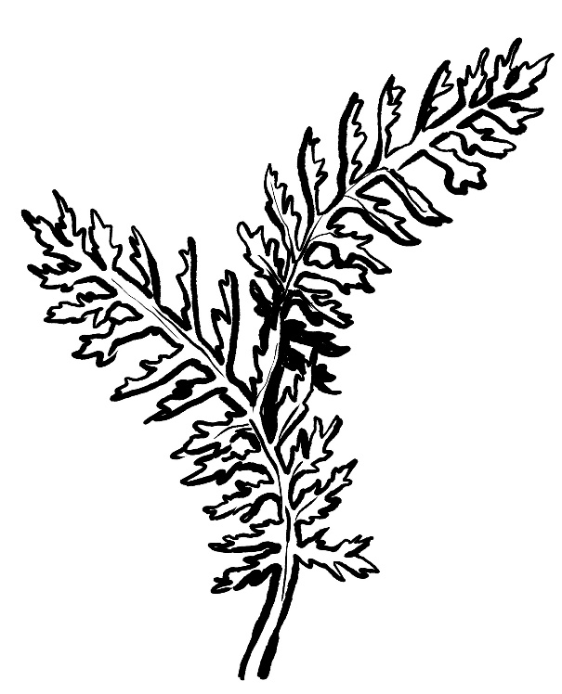
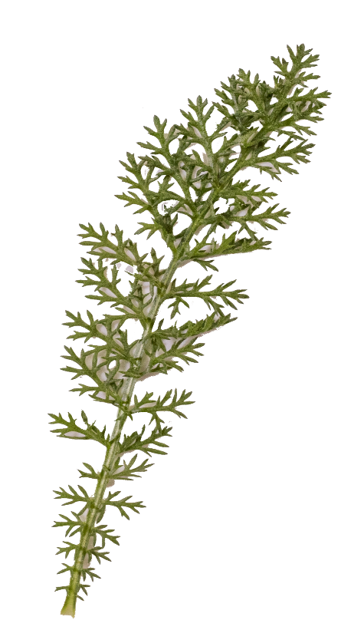
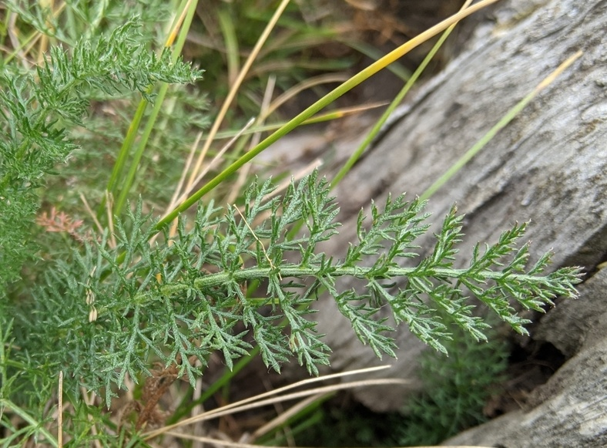
Yarrow
Tolerant of dry environments and some mowing.

Slide 30
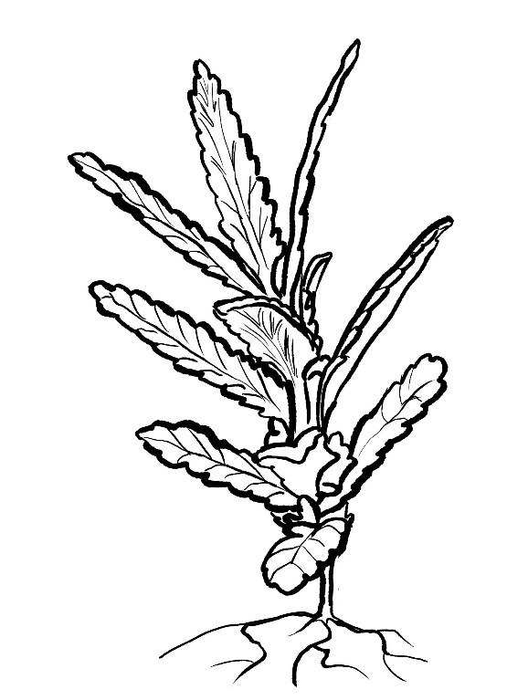
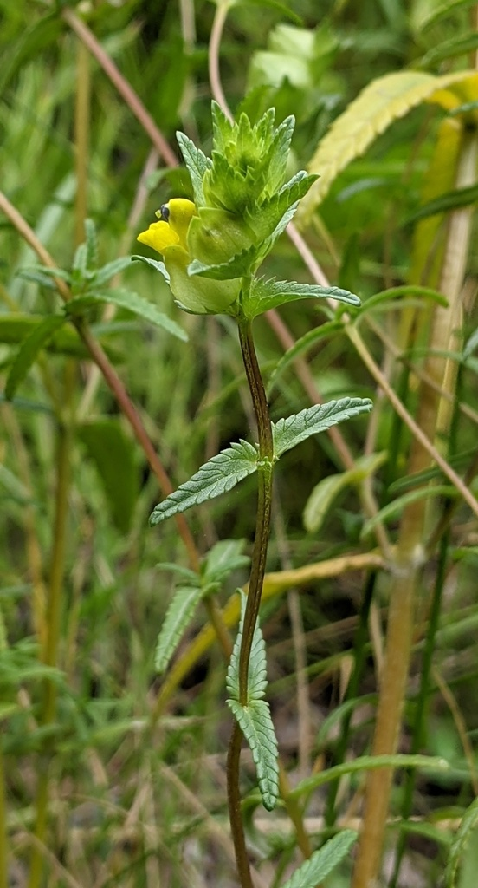


Yellow rattle
Tolerant of nutrient-poor soils.
Not tolerant of trampling or mowing.
Yellow rattle is a parasite of grasses. Its roots attach to the roots of grasses and draw nutrients from them. This slows the growth of grasses and lets other plants compete for space, water and nutrients.
People sometimes grow yellow rattle in lawns they are trying to turn into meadows.

Slide 31
Practice

Slide 32
Use the indicator species tables and the example quadrats to practice doing the Grassland Plant Survey and inferring the quality of the habitat using the indicator species.
Go outside and find a few areas where you can do the Grassland Plants Survey. Then use the tables with your survey results to learn more about the qualities of the grasslands around your site.

